Slide 1



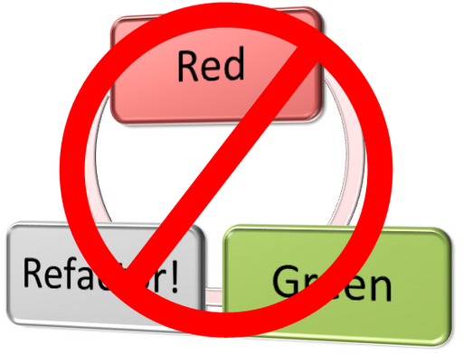
Test-Driven Development (TDD)
Learn the "Test First" Approach to Coding
Telerik Software Academy
Learning & Development
http://academy.telerik.com

Slide 2

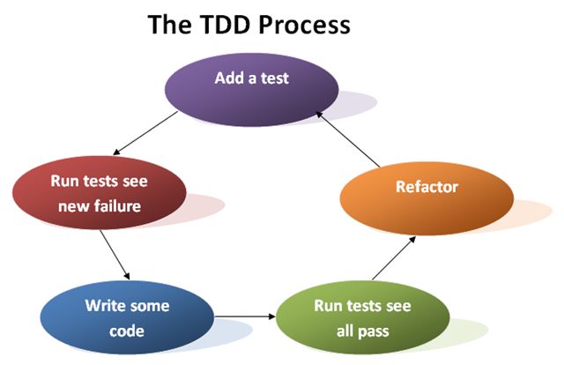
Code and Test vs. Test Driven Development

Slide 3
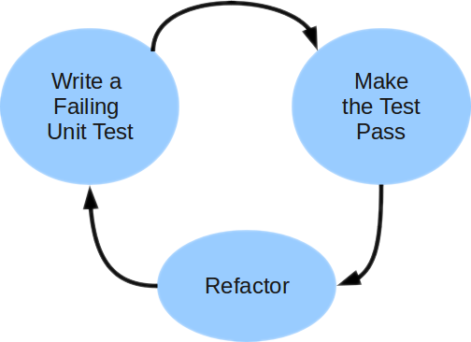
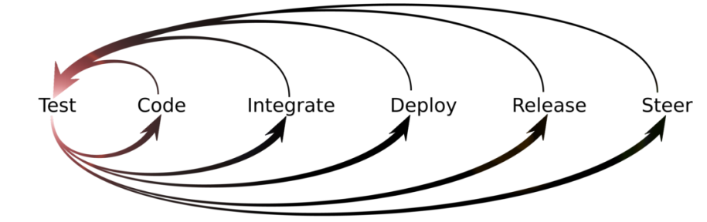
Unit Testing Approaches
"Code First" (code and test) approach
Classical approach
"Test First" approach
Test-driven development (TDD)

Slide 4
Code and Test Approach
Write code
Write unit test
Run and succeed
Time flow

Slide 5
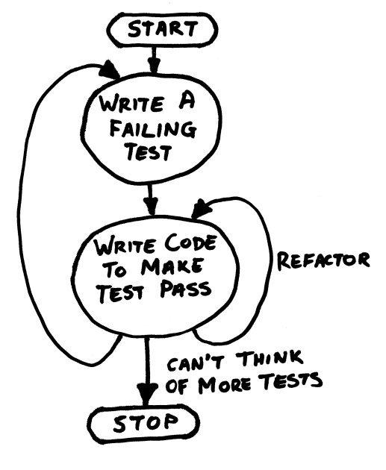
TDD in One Slide

Slide 6
Test-Driven Development (TDD)
Create a test list
Pick а test
Write test
Compile and fail
Write enough code to compile
Run test and fail
Write code to pass test
Time flow
Remove duplication

Slide 7


Why TDD?
TDD helps find design issues early
Avoids rework
Writing code to satisfy a test is a focused activity
Less chance of error
Tests will be more comprehensive than when written after code

Slide 8
Myths and Misconceptions
You create a 100% regression test suite
The unit tests form 100% of your design specification
You only need to unit test
TDD is sufficient for testing
TDD doesn't scale (partially true)
Your test suite takes too long to run
Not all developers know how to test
Everyone might not be taking a TDD approach

Slide 9

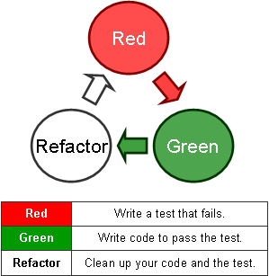
Test-Driven Development
Live Demo: Poker Hands Checker

Slide 10
Test-Driven Development (TDD)
http://academy.telerik.com

Slide 11
Homework
Finish the "Poker" project given in the Visual Studio Solution "11. Test-Driven-Development-Demo+Homework.zip" using TDD.
Write a class Card implementing the ICard interface. Implement the properties. Write a constructor. Implement the ToString() method. Test all cases.
Write a class Hand implementing the IHand interface. Implement the properties. Write a constructor. Implement the ToString() method. Test all cases.
Write a class PokerHandsChecker (+ tests) and start implementing the IPokerHandsChecker interface. Implement the IsValidHand(IHand). A hand is valid when it consists of exactly 5 different cards.

Slide 12
Homework (2)
Implement IPokerHandsChecker.IsFlush(IHand) method. Follow the official poker rules from Wikipedia: http://en.wikipedia.org/wiki/List_of_poker_hands
Implement IsFourOfAKind(IHand) method. Did you test all the scenarios?
* Implement the other check for poker hands: IsHighCard(IHand hand), IsOnePair(IHand hand), IsTwoPair(IHand hand), IsThreeOfAKind(IHand hand), IsFullHouse(IHand hand), IsStraight(IHand hand) and IsStraightFlush(IHand hand). Did you test all the scenarios well?
* Implement a card comparison logic for Poker hands (+ tests). CompareHands(…) should return -1, 0 or 1.

Slide 13




Free Trainings @ Telerik Academy
C# Programming @ Telerik Academy
csharpfundamentals.telerik.com
Telerik Software Academy
academy.telerik.com
Telerik Academy @ Facebook
facebook.com/TelerikAcademy
Telerik Software Academy Forums
forums.academy.telerik.com

